Slide 1

VIRAT Video and Interaction Relay Associated Tool

Slide 2
Contributions
Dheeraj Kumar Singh (21114034)​​ (+917477216867) - UML Designing(Use Case Diagram), Login Page Backend, Dashboard Chat Frontend, Watch Party Room Backend, Watch Party Player Backend, PPT Documentation, PPT Narration
Garvit Goyal (21114036)​​ (+918094491575) - UML Designing(Use Case Diagram), Signup Page Backend, Watch Party Index Page Frontend, Video Call Implementation, Invalid Page Implementation, Final Report Documentation, PPT Narration
Gyanendra Kumar Banjare (21114040) (+917987017501) – UML Designing(Class Diagram), Group Implementation, Watch Party Chat Implementation, Watch Party Player Frontend, Heroku Deployment, PPT Documentation, Database Setup, PPT Narration

Slide 3
Contributions
Jayesh Vyas (21114044) (+919461946772) – UML Designing(Sequence Diagram), Login Page Frontend, Group Implementation, Dashboard Miscellaneous Implementations, Video Call Implementation, Project Development Documentation, PPT Narration
​​Kulkarni Sourabh Shrinivasrao (21114053)​​ (+917756086424) - UML Designing(Sequence Diagram), Signup Page Frontend, Dashboard Chat Backend, Watch Party Chat Implementation, Project Development Documentation, PPT Narration
Shrey Gupta (21112103) (+918383898494) – UML Designing(Class Diagram), Dashboard Chat Backend, Group Frontend, Dashboard Frontend, Final Report Documentation, Github Setup, PPT Narration, Logo Design

Slide 4
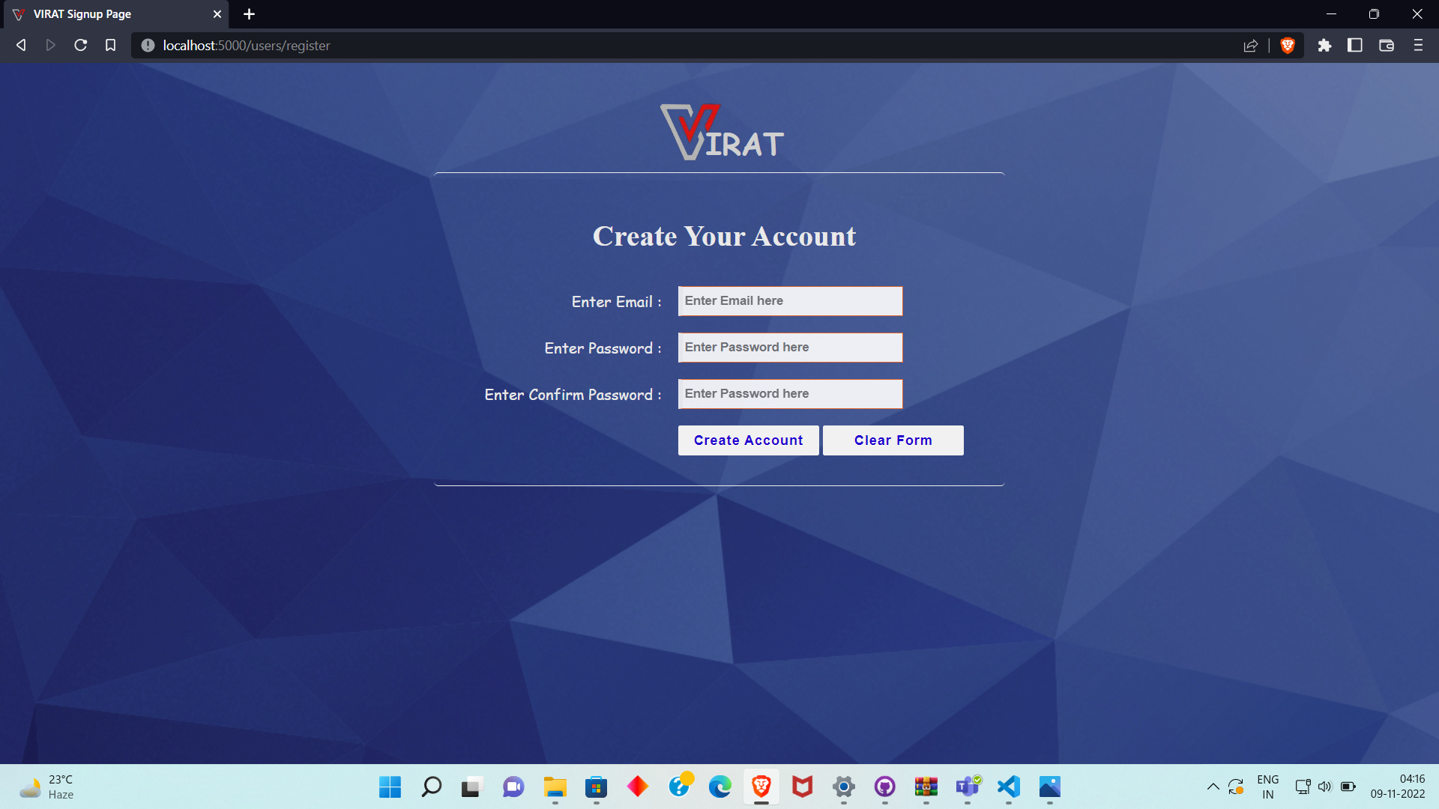

Signup Page

Slide 5
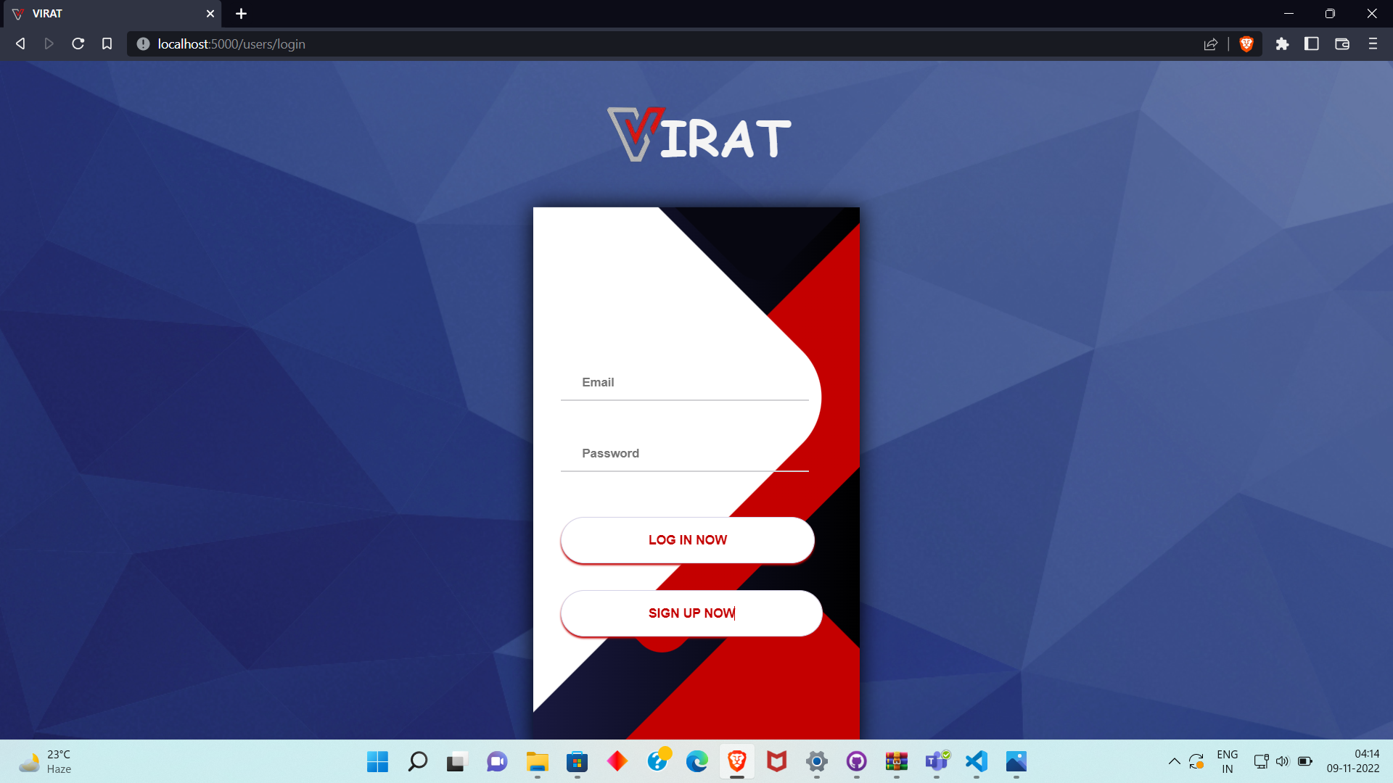
login Page

Slide 6
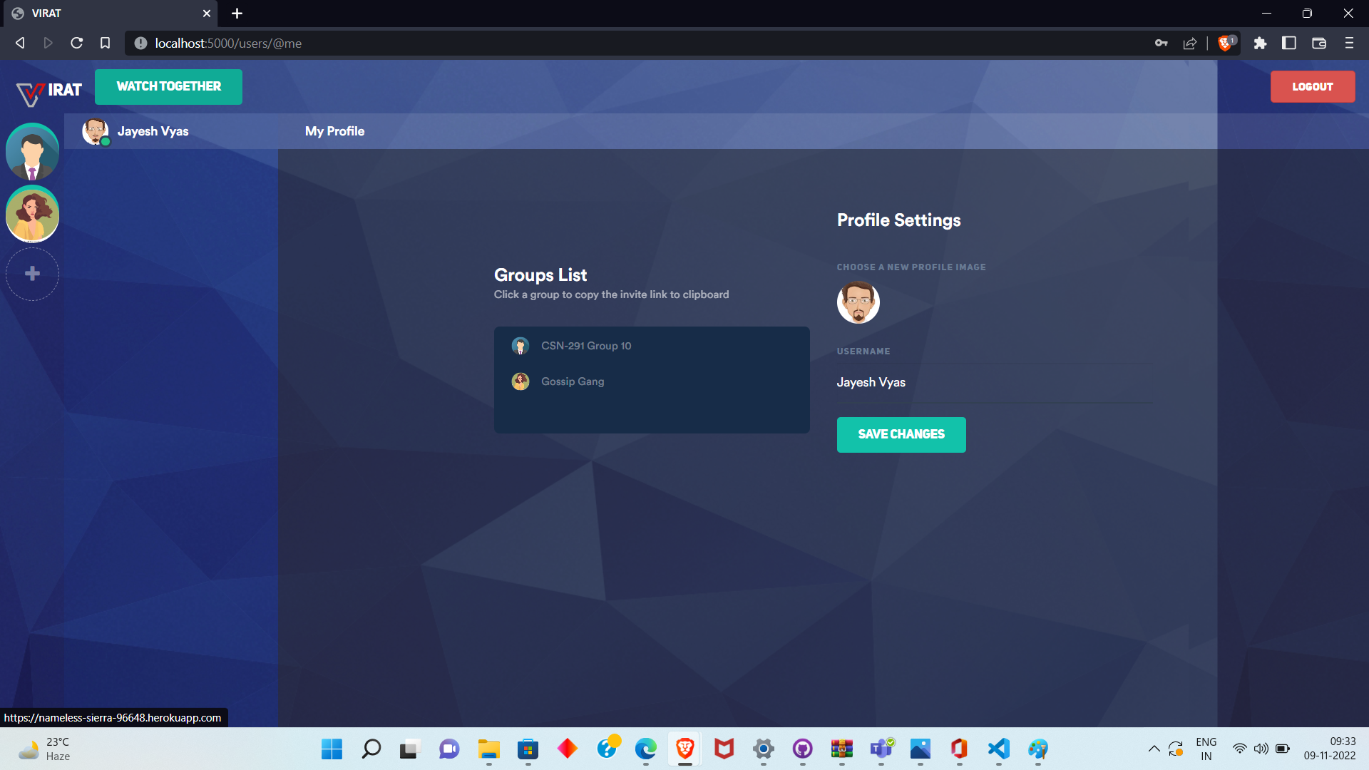
Dashboard

Slide 7
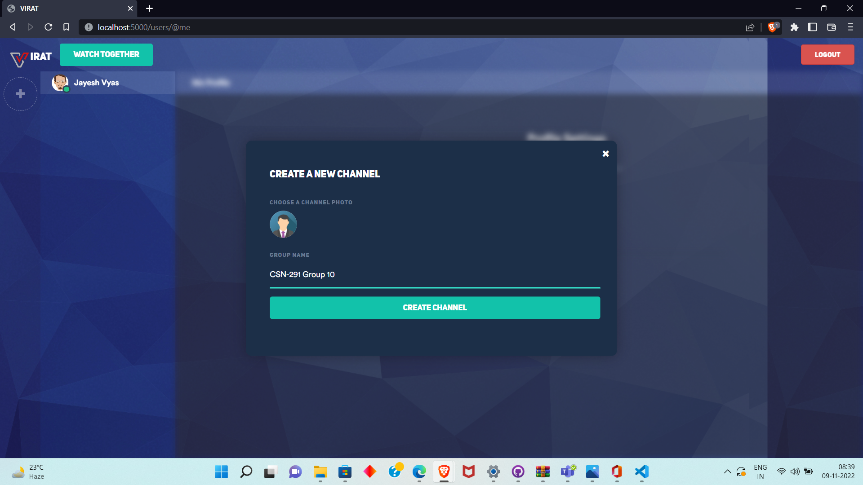
Create a new group

Slide 8
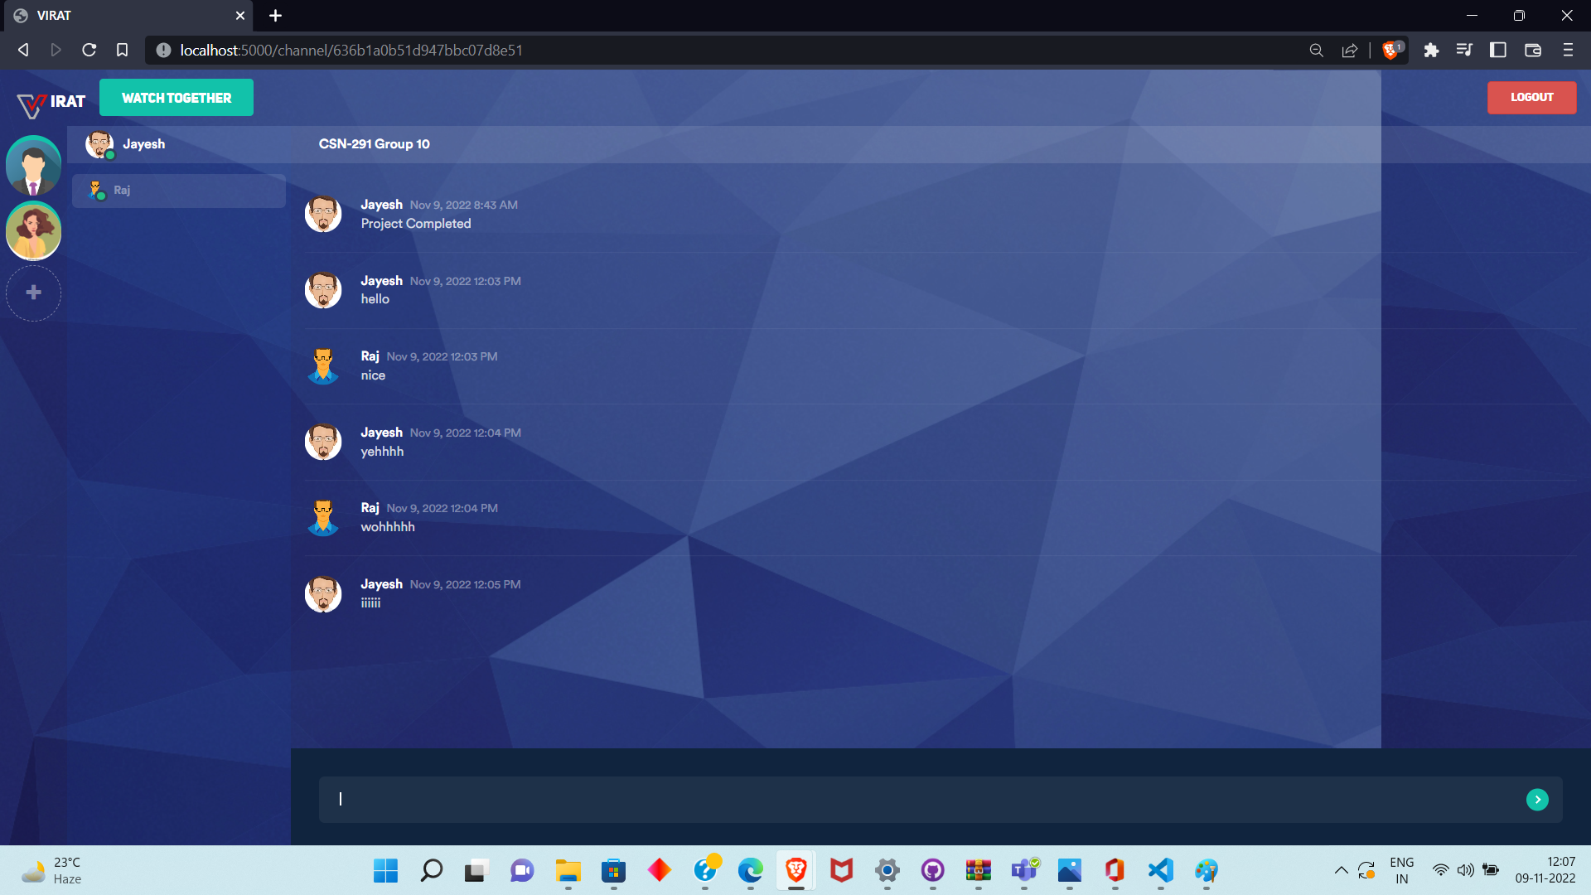
Chatting in a group

Slide 9
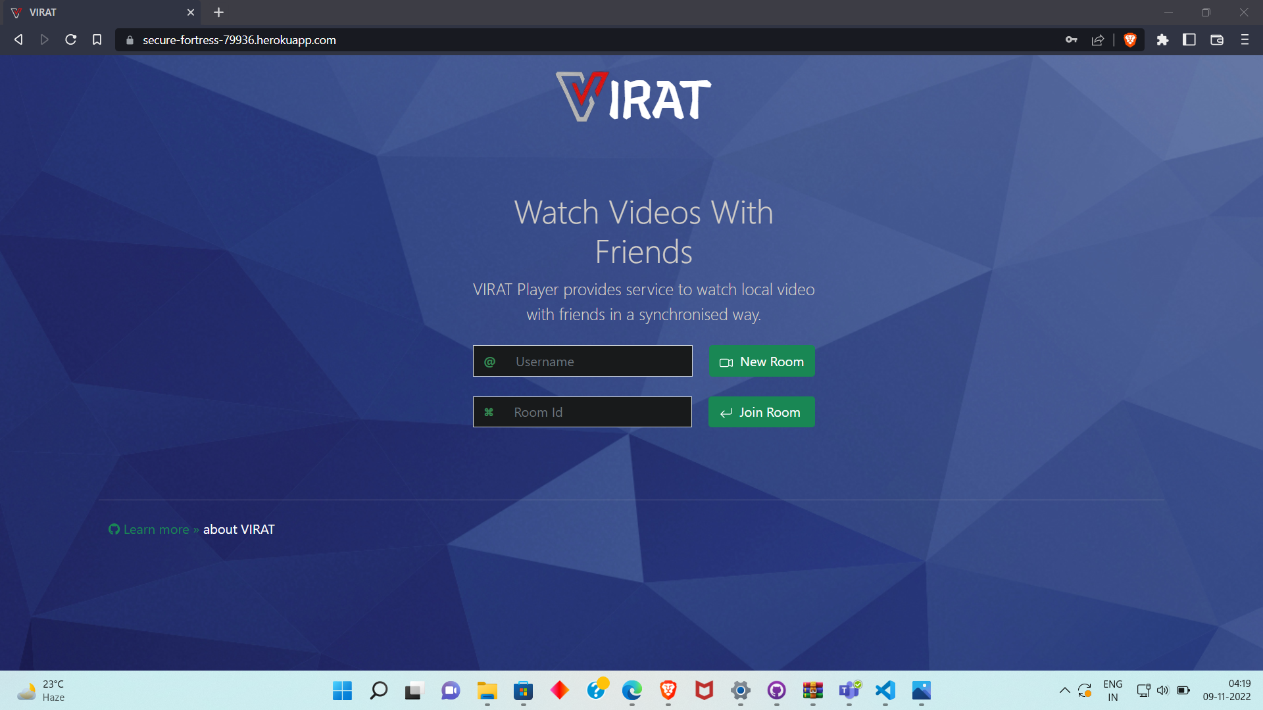
Watch Party Login

Slide 10
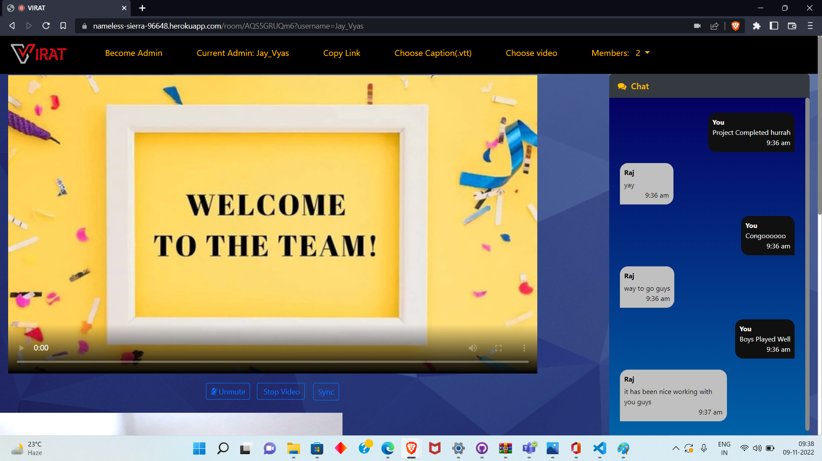
Watch Party

Slide 11
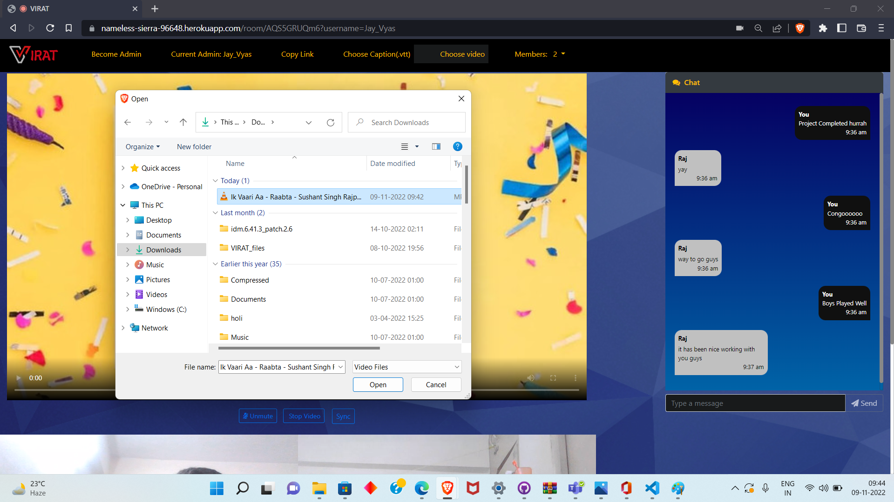
Selecting video to watch together

Slide 12
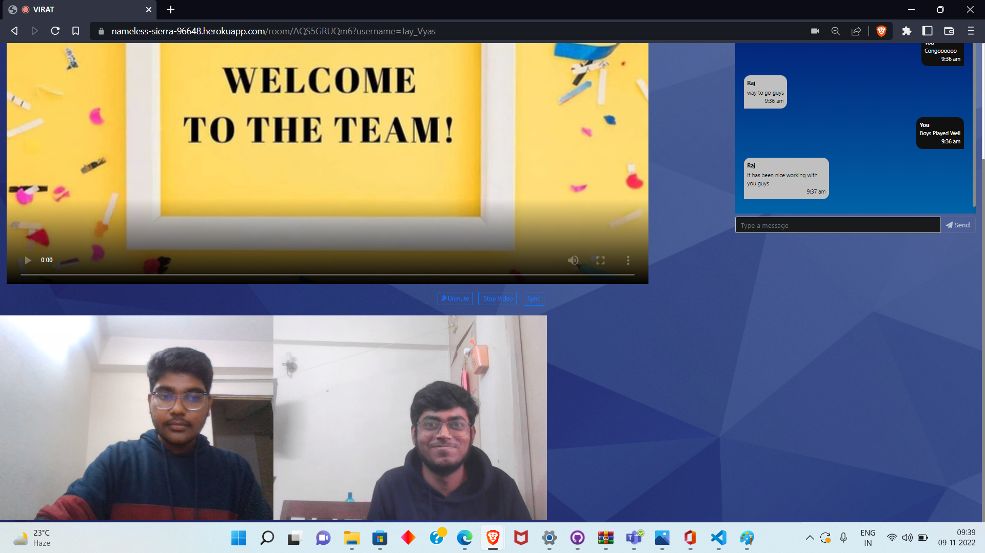
Video call in Watch Party

